Slide 1
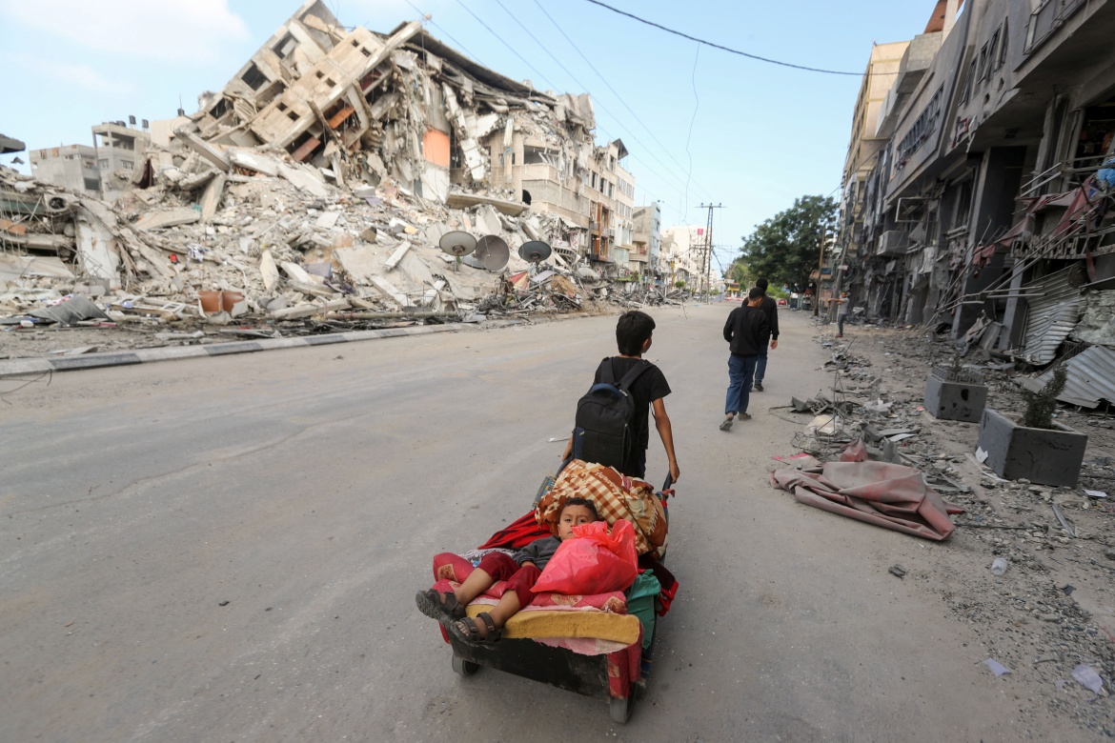
What are the consequences of the blockade on Gaza?
Lesson 15
A Palestinian boy pulls a cart carrying his brother and their belongings as they flee from Israeli attacks on Gaza in 2021

Slide 2
Learning objectives
By the end of this lesson, you should be able to:
Describe the blockade on Gaza
Explain the consequences of this
Assess the humanitarian crisis in Gaza
What does ‘assess’ mean?
To analyse; to think about the nature of something

Slide 3
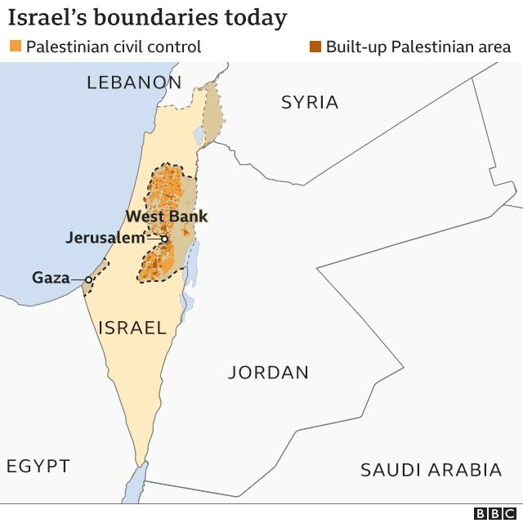
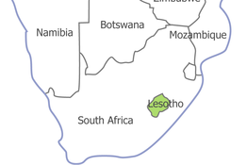
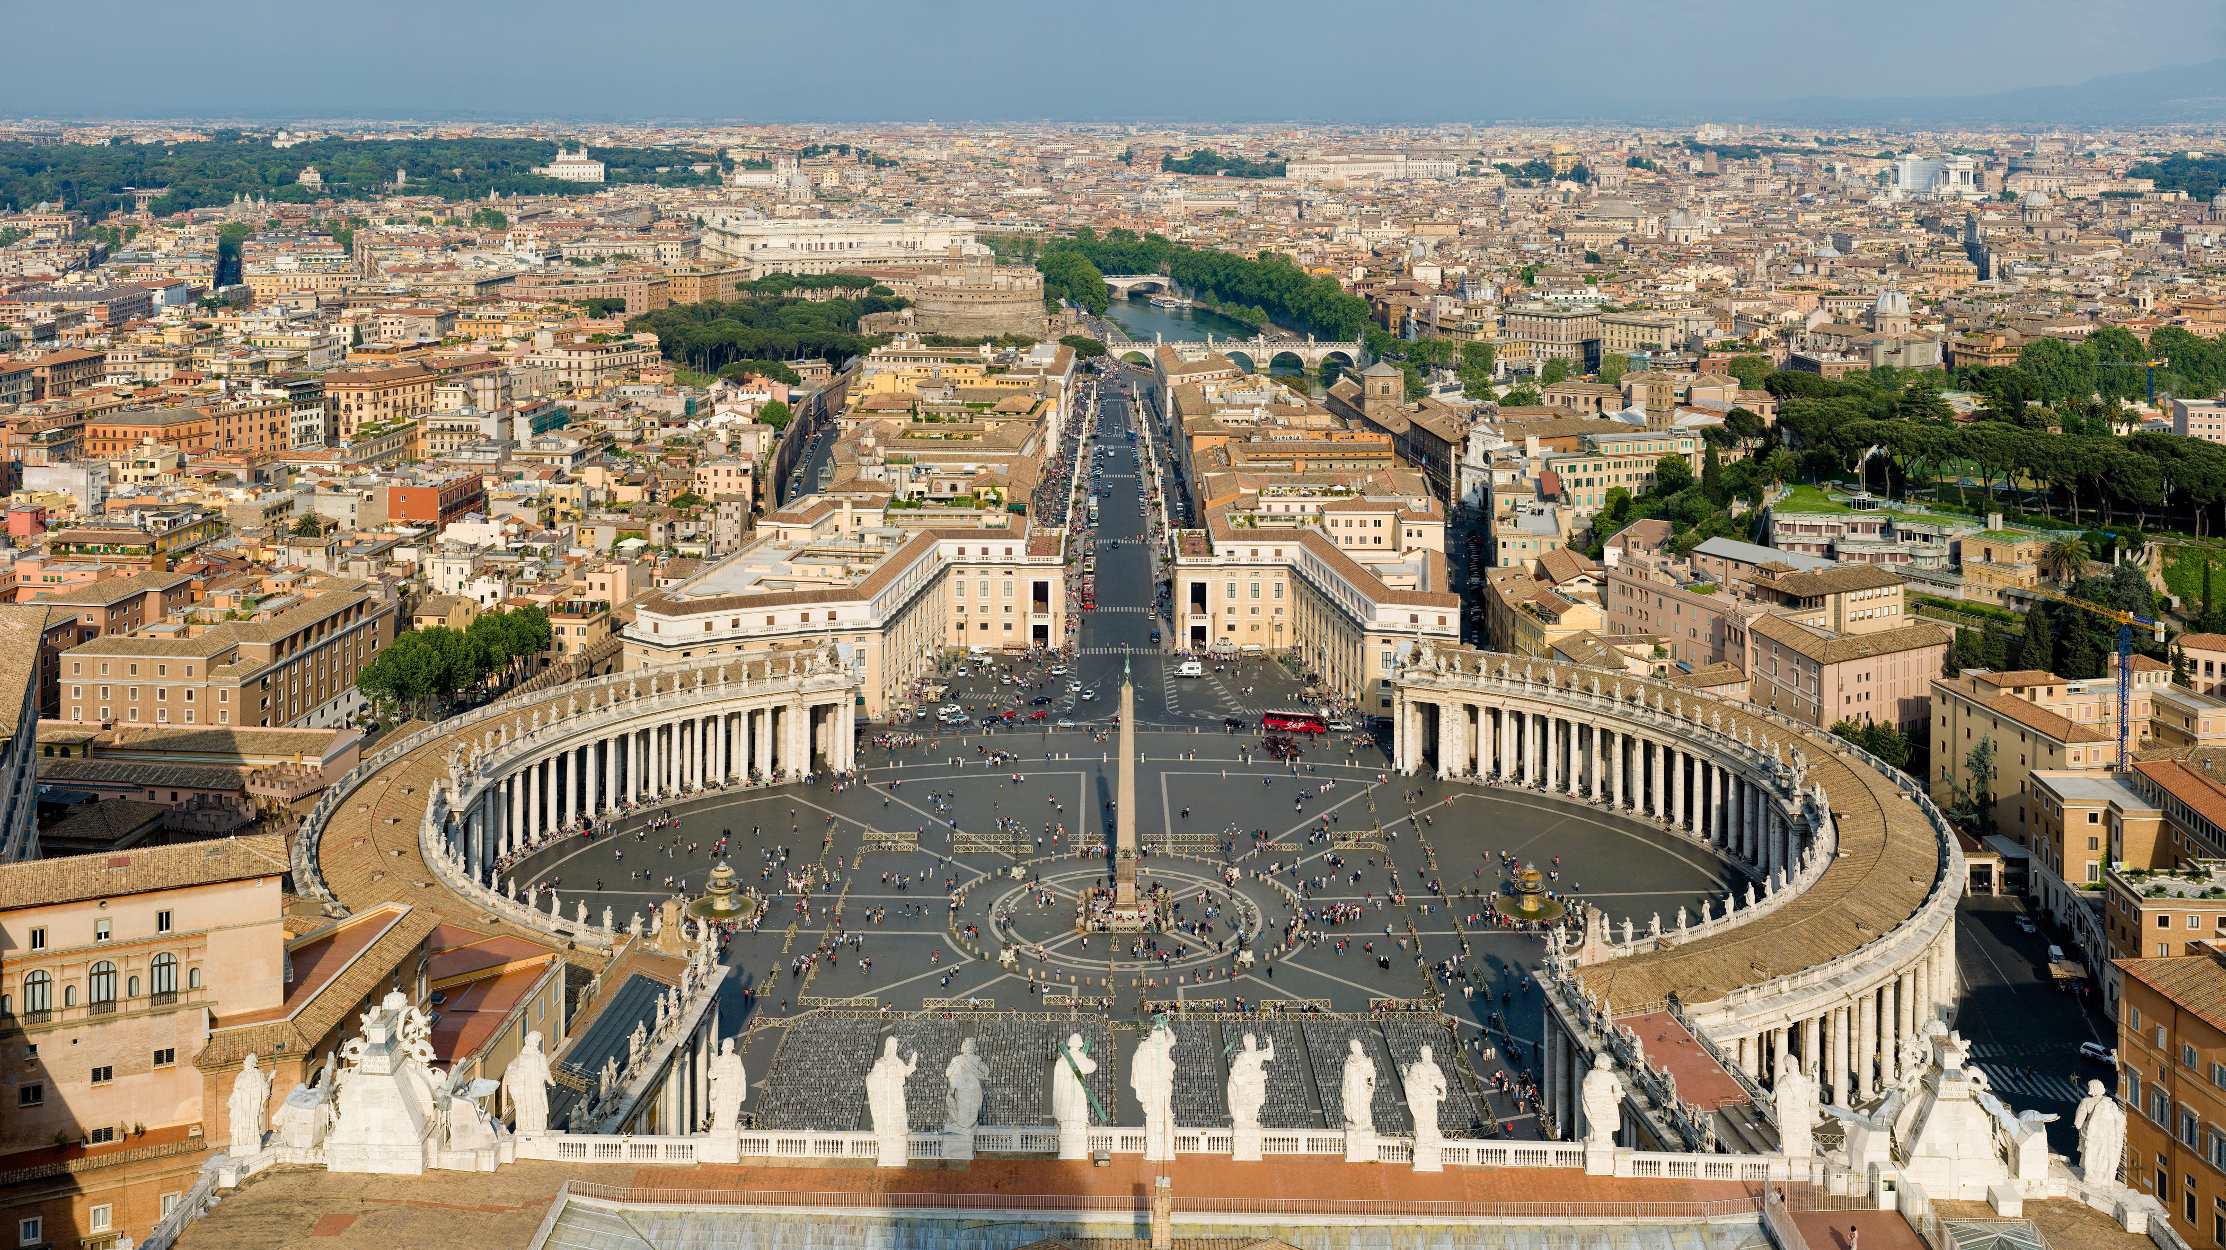
15a. Keywords
Land entirely surrounded by the land or sea of another country (for example Lesotho)
Cut out and match these keywords with their definitions
A Palestinian enclave on the Mediterranean coast, which borders Egypt and Israel
Blockade
Enclave
When land is sealed off to prevent people or goods from entering or leaving
Gaza
Humanitarian crisis
When the health, wellbeing or safety of a large group of people is seriously threatened
Extension question - can you think of any other examples of an enclave? Hint:

Slide 4
Today’s keywords
Blockade: When land is sealed off to prevent people or goods from entering or leaving
Enclave: Land entirely surrounded by the land or sea of another country (for example Lesotho)
Gaza: A Palestinian enclave on the Mediterranean coast, which borders Egypt and Israel
Humanitarian crisis: When the health, wellbeing or safety of a large group of people is seriously threatened
Had you come across any of these before today?
Where?

Slide 5
Locating Gaza on the map:

Slide 6
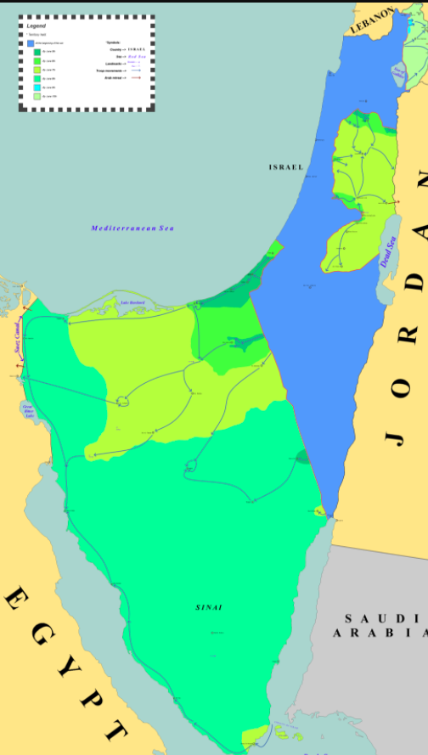
Recap
In small groups:
What happened to Gaza in 1967?
Hint: what can you remember about this map from Lesson 9?

Slide 7
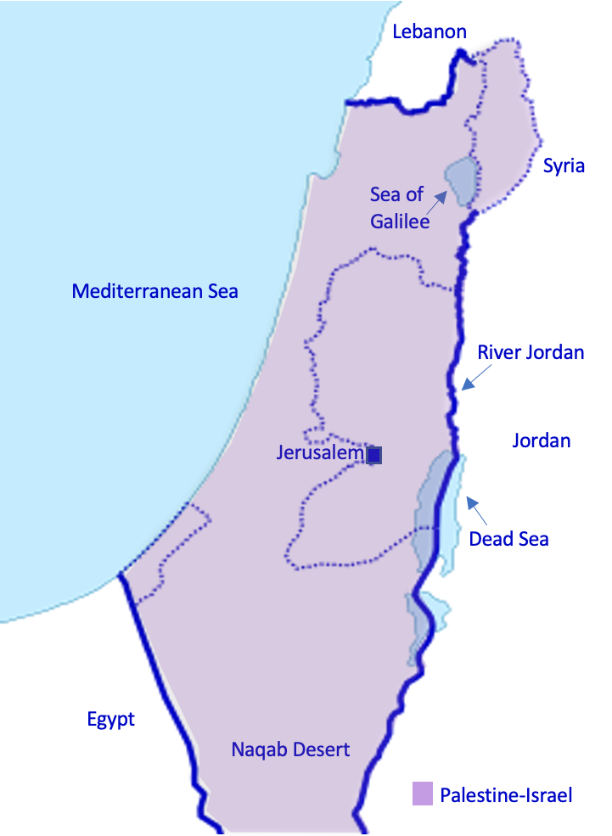
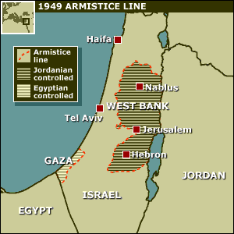
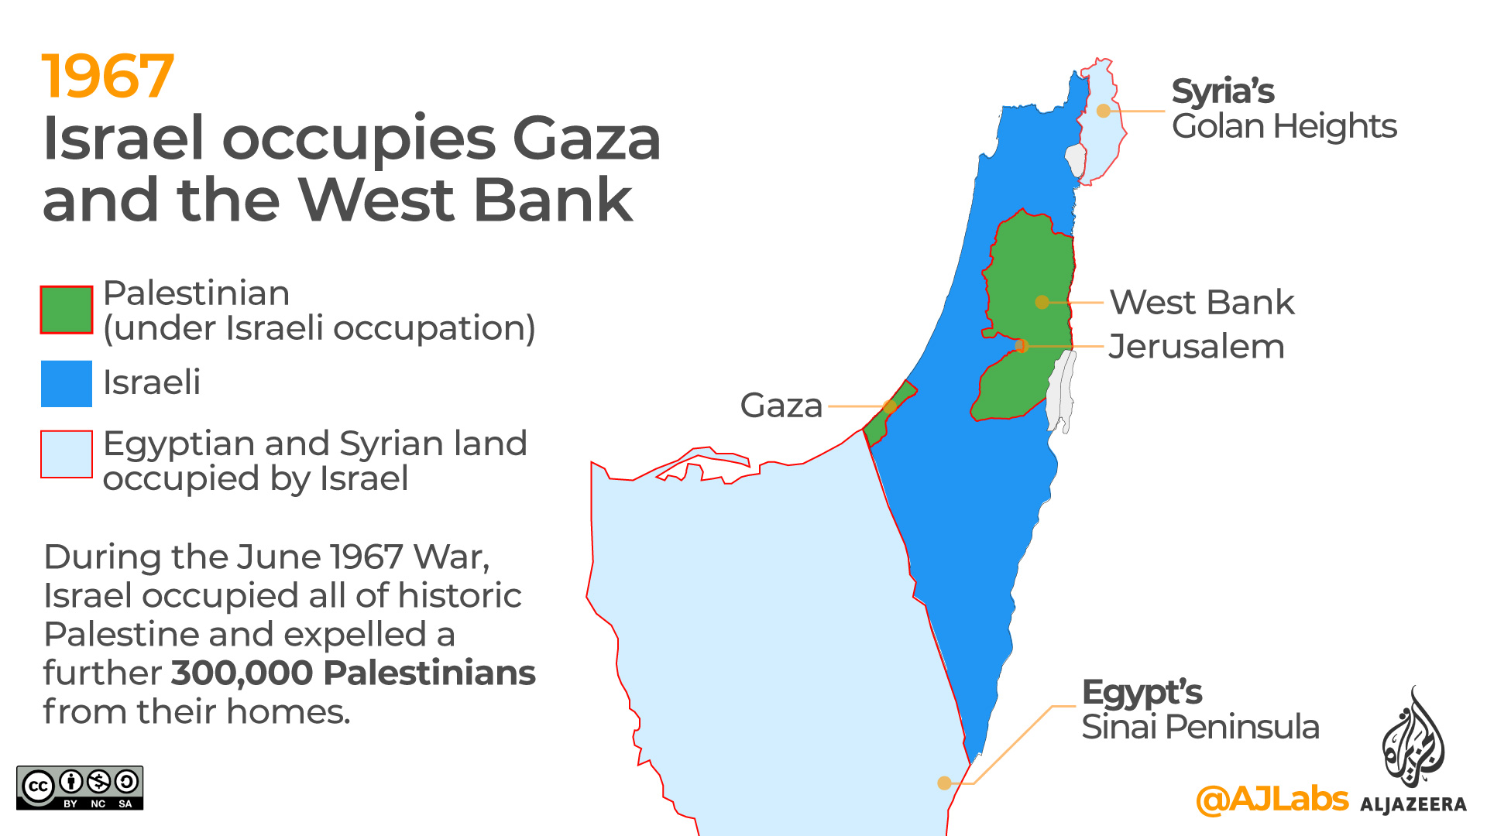
Recap
1.
2.
Gaza is part of historic Palestine-Israel
After the Nakba of 1948, Gaza was controlled by Egypt
In 1967, Israel invaded and took control (it occupied Gaza)
3.

Slide 8
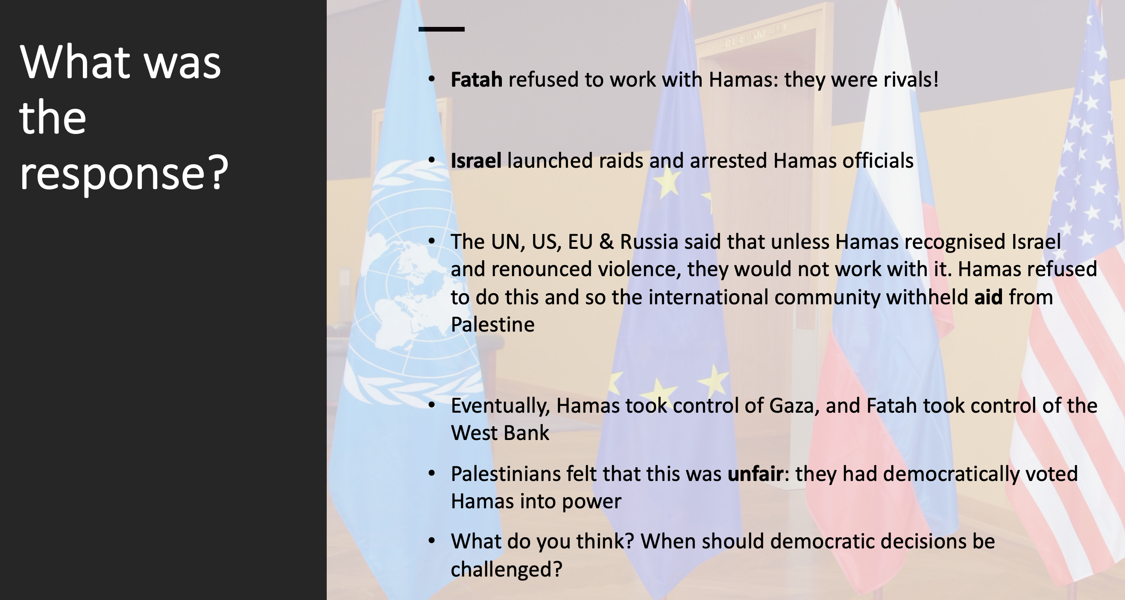
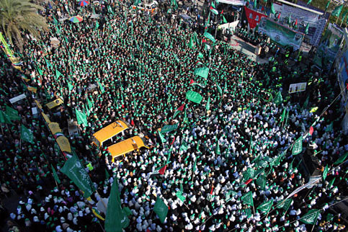
Hamas in Gaza
Today we are looking at what has happened in Gaza since 1967, particularly since 2006
Last lesson we looked at the 2006 Palestine election, won by Hamas
Fatah didn’t accept the result and took control of the West Bank
Hamas took control of Gaza

Slide 9
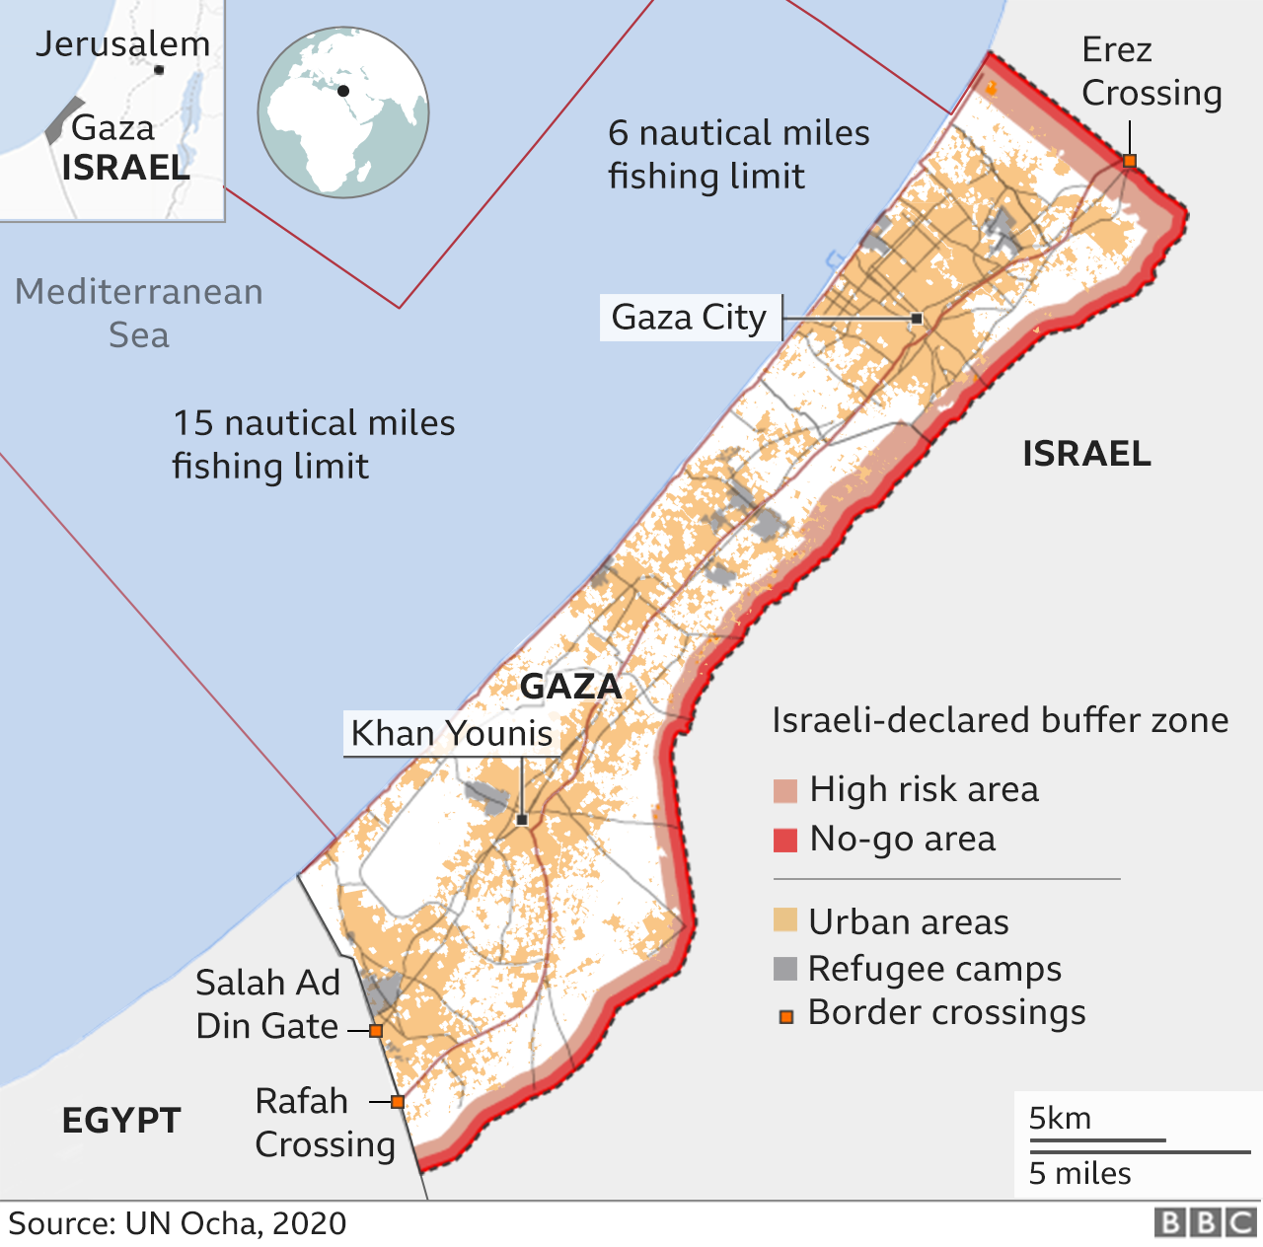
15b. The blockade of Gaza
Blockade: When land is sealed off to prevent people or goods from entering or leaving
Since 2007, Gaza has been under blockade by Israel because of concerns about Hamas (and Israel wanting more control over Palestinian land)
This is an air, land and sea blockade
Since 2007, nothing has been able to get in or out of Gaza, except a very limited amount of aid and a few people
Some of the items not allowed into Gaza include crayons, footballs, musical instruments, wheelchairs, soap, shampoo, wood and concrete
2 million people live in Gaza, an area of land the size of Sheffield in the UK or Lucknow in India
In small groups:
1. List 3 things this map tells you about Gaza
2. Can you imagine your life without the objects listed above?

Slide 10
15c. Timeline activity
Since Israel imposed the blockade on Gaza in 2007, there have been many wars and attacks by Israel. In pairs, create a timeline of the violence in Gaza using the information cards on this page
A 3-week armed conflict took place between Israel and Hamas from 27th December 2008 until 18th January 2009. 1000 Palestinians and 13 Israelis were killed. This is known as the Gaza Massacre or Operation Cast Lead
Fatah did not accept the 2006 election result and kept control of the West Bank while Hamas took control of Gaza
On 8th July 2014, Israel launched Operation Protective Edge. Over 7 weeks of fighting, over 2000 Gazans were killed and 10,000 Gazans were wounded, including 1000 children who were left permanently disabled. 72 Israelis were killed
Israel imposed an air, land and sea blockade on Gaza in June 2007
In the January 25th 2006 Palestine election, Hamas won. Hamas secured 44% of the vote compared to only 41% for Fatah
On 14th November 2012, Israel launched Operation Pillar of Defense on Gaza. Over 8 days, 167 Palestinians were killed, 87 of whom had not been involved in the fighting. 2 Israelis were killed
Between 6th and 21st May 2021, the 2021 Israel-Palestine Crisis occurred. Triggered by the forced evictions of Palestinian families from their homes in East Jerusalem, over 200 Palestinians were killed
Extension question:
How many Palestinians and how many Israelis were killed in each of the following?
a) Operation Cast Lead
b) Operation Pillar of Defense
c) Operation Protective Edge

Slide 11
15c. Timeline activity
Fatah did not accept the 2006 election result and kept control of the West Bank while Hamas took control of Gaza
A 3-week armed conflict took place between Israel and Hamas from 27th December 2008 until 18th January 2009. 1000 Palestinians and 13 Israelis were killed. This is known as the Gaza Massacre or Operation Cast Lead
On 8th July 2014, Israel launched Operation Protective Edge. Over 7 weeks of fighting, over 2000 Gazans were killed and 10,000 Gazans were wounded, including 1000 children who were left permanently disabled. 72 Israelis were killed
In the January 25th 2006 Palestine election, Hamas won. Hamas secured 44% of the vote compared to only 41% for Fatah
Israel imposed an air, land and sea blockade on Gaza in June 2007
On 14th November 2012, Israel launched Operation Pillar of Defense on Gaza. Over 8 days, 167 Palestinians were killed, 87 of whom had not been involved in the fighting. 2 Israelis were killed
Between 6th and 21st May 2021, the 2021 Israel-Palestine Crisis occurred. Triggered by the forced evictions of Palestinian families from their homes in East Jerusalem, over 200 Palestinians were killed

Slide 12
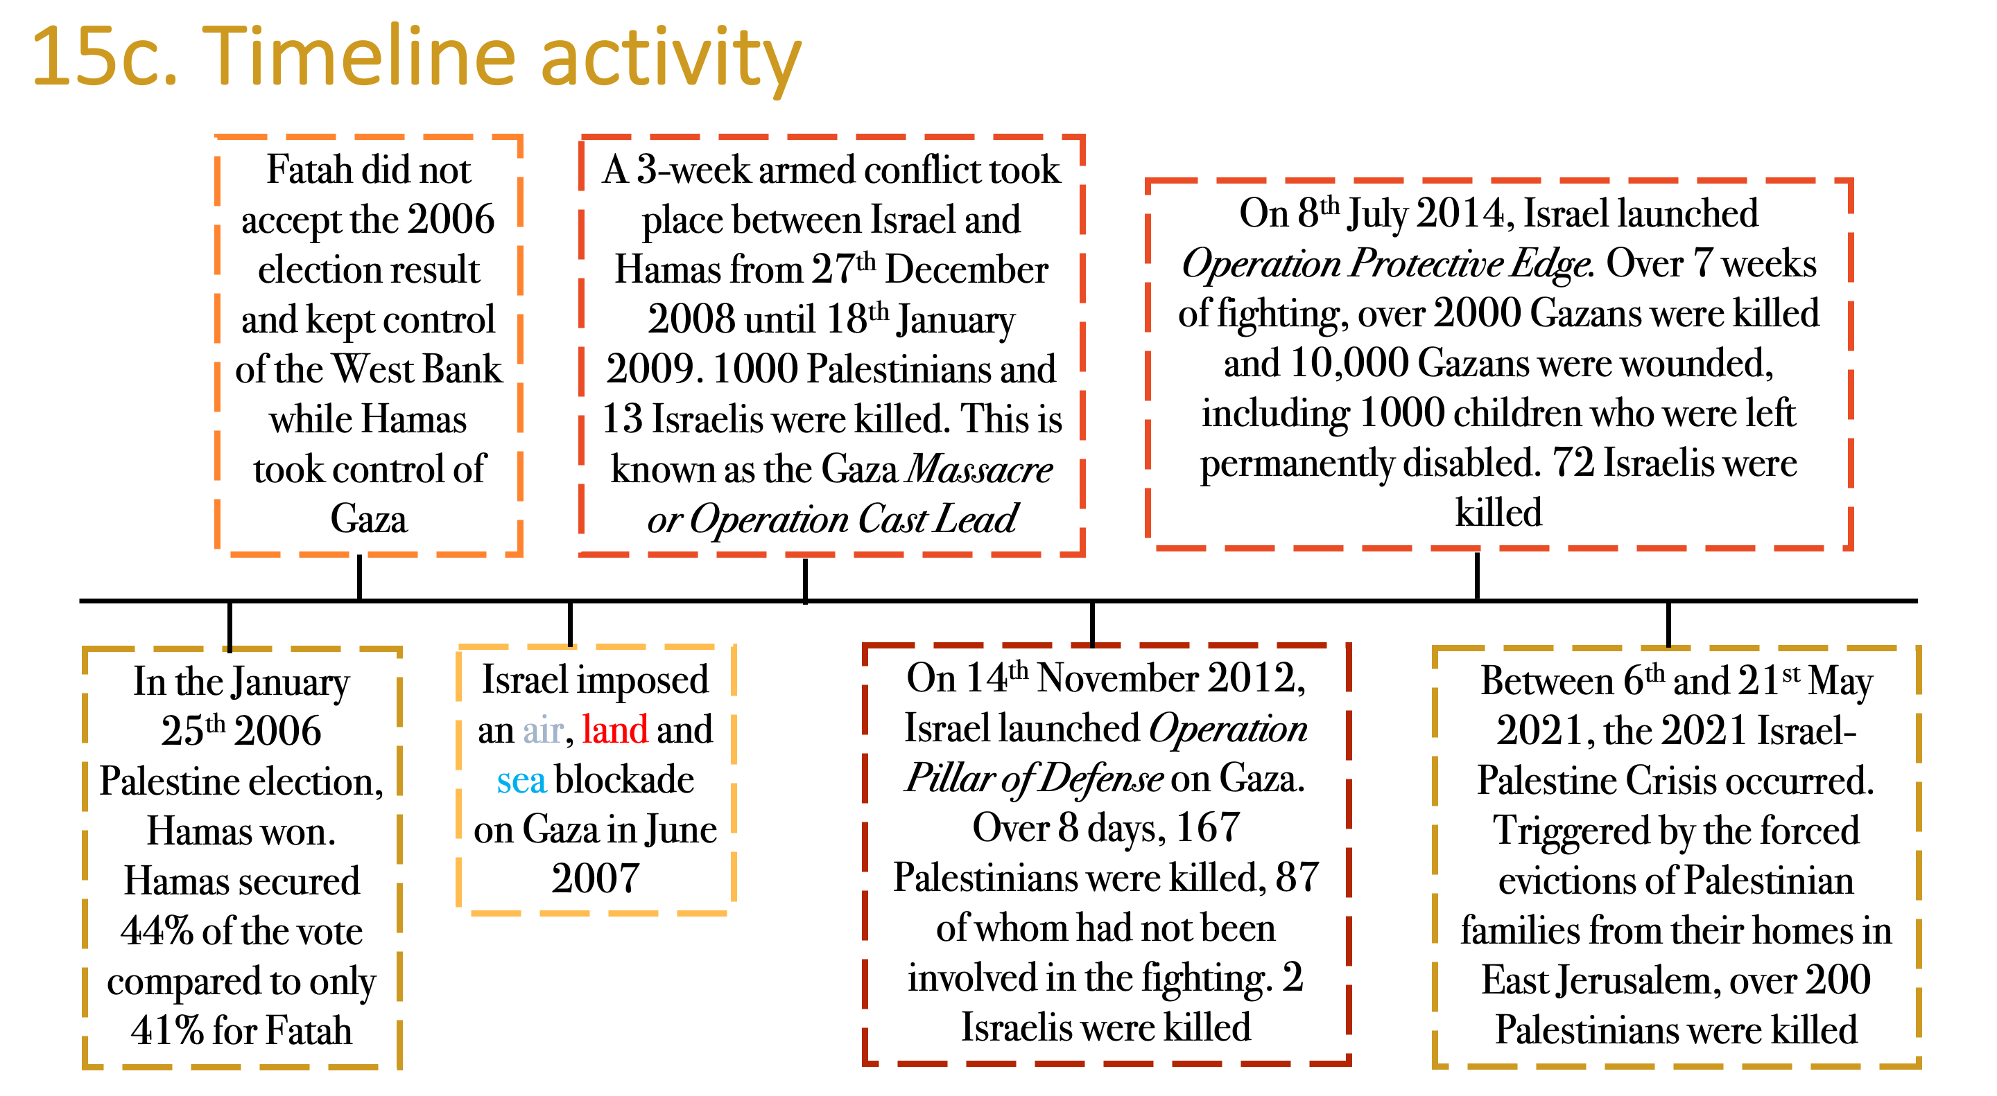
Working independently, use your timeline to answer this question in your book:
If you had been born in Gaza in 2007, what would you have experienced by now?

Slide 13
Watch this video about life in Gaza: https://vimeo.com/632224922

Slide 14
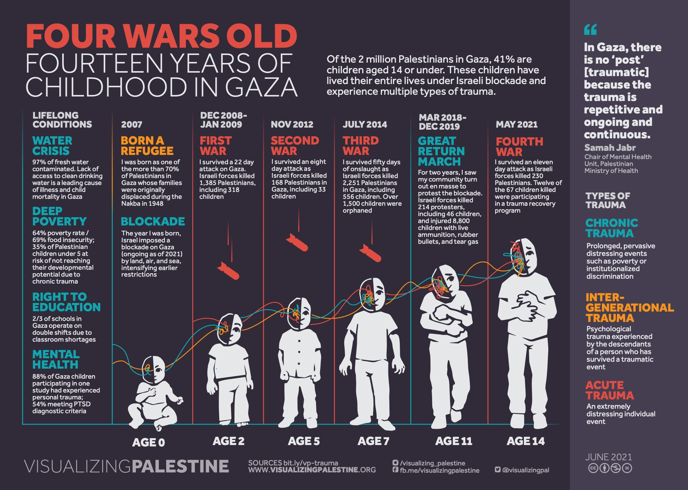

Slide 15

Photos of life in Gaza

Slide 16
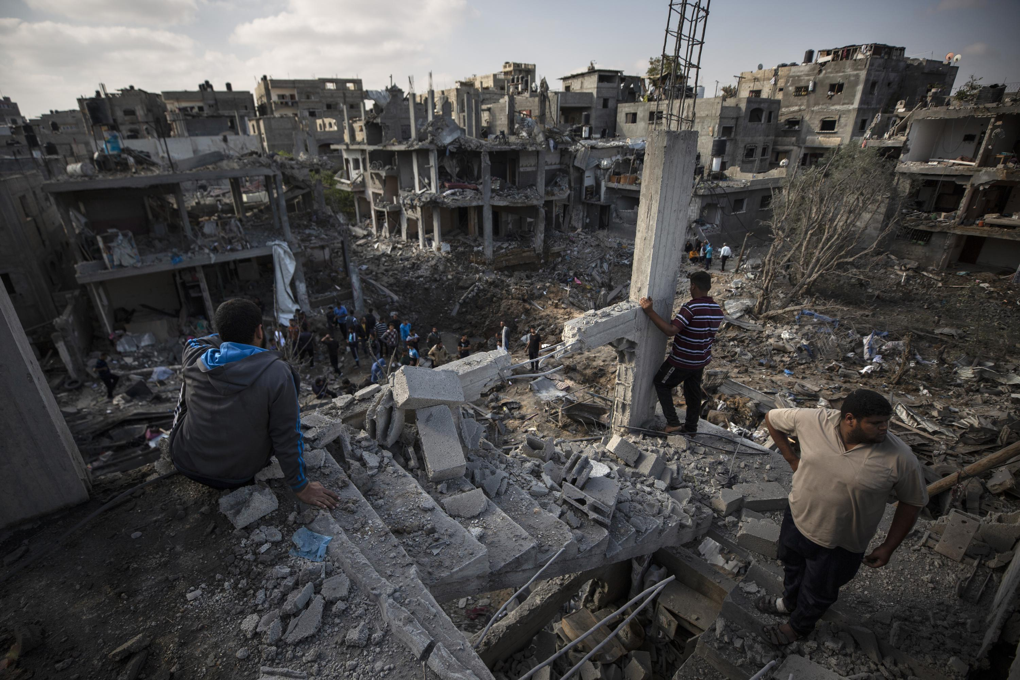
What can you see in this photo?
What does this tell you about Gaza?

Slide 17
What can you see in this photo?
What does this tell you about Gaza?

Slide 18
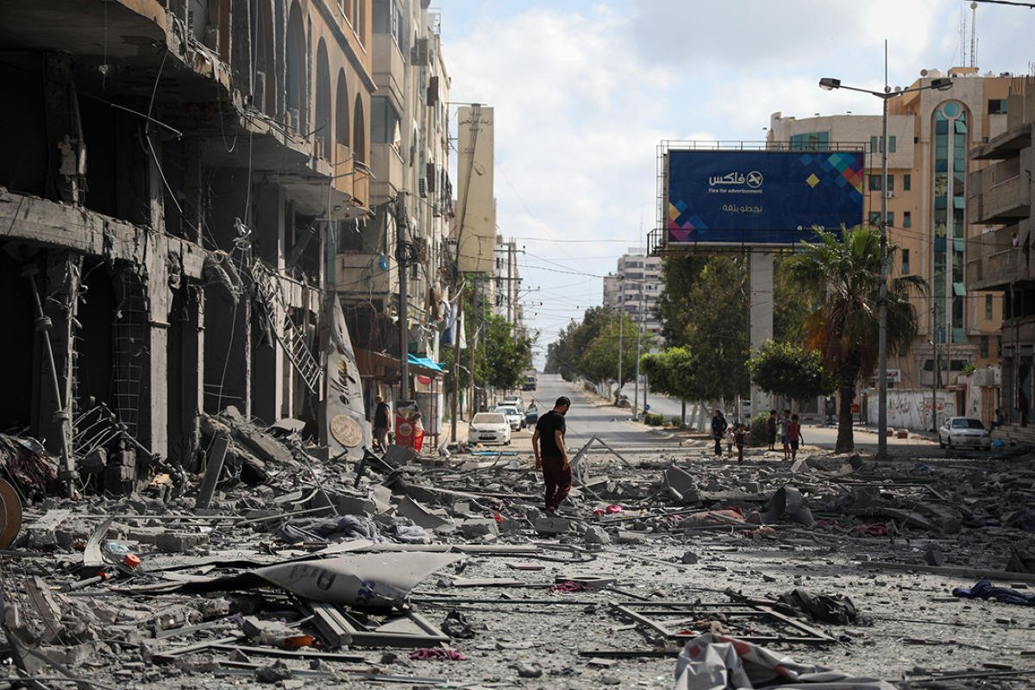
What can you see in this photo?
What does this tell you about Gaza?

Slide 19
Working in small groups, use the photos to help you answer these questions:
Is it possible to rebuild without wood or concrete?
Is this a humanitarian crisis?
Humanitarian crisis: When the health, wellbeing or safety of a large group of people is seriously threatened

Slide 20

Gaza’s humanitarian crisis
Humanitarian crisis: When the health, wellbeing or safety of a large group of people is seriously threatened
Gaza has been experiencing a humanitarian crisis for many years now, and the situation is only getting worse
Food, water, medicine and fuel are all scarce in Gaza
Nearly 80% of the population is in need of humanitarian aid
1.3m Palestinians in Gaza do not have access to adequate safe drinking water
There is only electricity for a few hours each day
43% of Palestinians in Gaza are unemployed
Gaza has been described as “the world’s largest open-air prison”

Slide 21
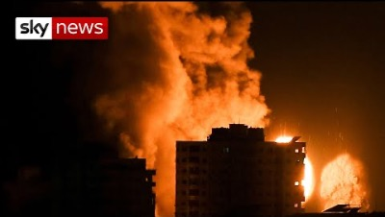
Life in Gaza:
https://www.youtube.com/watch?v=lR2b7q2Kzrg&feature=emb_logo

Slide 22
15d. What have the UN and human rights organisations said about the situation in Gaza?
Both the UN and leading international human rights organisations have condemned the situation in Gaza
“With an economy in free fall, 70 per cent youth unemployment, widely contaminated drinking water and a collapsed health care system, Gaza has become ‘unliveable’”
United Nations, October 2018
“The scale of suffering is immense”
Oxfam, May 2021
“Israeli forces have displayed a shocking disregard for the lives of Palestinian civilians”
Amnesty International, May 2021
“Israel’s more than decade-long closure of Gaza severely restricts the movement of people and goods, with devastating humanitarian impact”
Human Rights Watch, December 2021
In small groups, create your own statement about the situation in Gaza. It should be no longer than 3 sentences. In a few minutes you will share your statement with the rest of the class

Slide 23
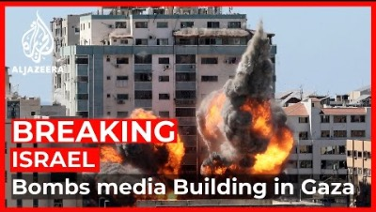
As well as civilians, Israel has targeted the international media in Gaza, who report on the ongoing humanitarian crisis there:
https://www.youtube.com/watch?v=bQjq802NX8g&feature=emb_logo

Slide 24


In your book, make a visual summary of what you have learned today about life in Gaza. For example:
Plenary
Footballs are not allowed into Gaza
Palestinians can only fish within a limited distance from the Gazan coast

Slide 25


Homework
Explain two consequences of the Israeli blockade on Gaza (8 marks)

